Slide 1

Diabetes Prediction App using Machine Learning: A CRISP-DM Approach to Health Data Analysis
Diab Risk

Slide 2

Team of 5 :-
Yash Bhati
Devna N
Chitrika Muthamma
Jyoshna
MP Navanath
[Advanced Data Science / DSA Component Mini Project]
27 October 2025

Slide 3
(CRISP-DM Phase 1) Introduction and Business Understanding
Problem Statement: To develop a machine learning model capable of accurately predicting diabetes risk using readily available health attributes and deploy it as a user-friendly Streamlit web application.
Business Objective: Provide individuals with an early, accessible, and real-time assessment of their diabetes risk, enabling timely awareness and preventative lifestyle changes.
Target Variable (y): Outcome (Binary: 1=Diabetic, 0=Non-Diabetic)
Team Objectives
Clean and preprocess the Diabetes dataset, specifically handling invalid zero values.
Train and evaluate two classification models: Logistic Regression and Random Forest.
Select the best-performing model based on key medical metrics (Recall and F1-score).
Deploy the best model and pre-processing pipeline via a Streamlit web app.

Slide 4
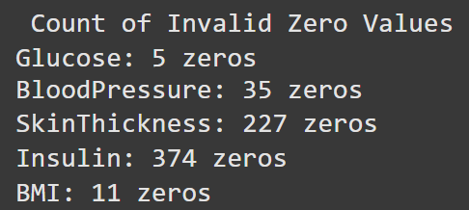
(CRISP-DM Phase 2)
Data Understanding :
2.1 Dataset Description
Size: 768 entries (patients) and 9 features.
Features:
Pregnancies
Glucose
BloodPressure
SkinThickness
Insulin
BMI
DiabetesPedigreeFunction
Age.
2.2 Initial Data Quality Assessment
The data contained biologically impossible zero values in Glucose, BloodPressure, SkinThickness, Insulin, and BMI, representing missing data.
These were handled to ensure reliable model training.

Slide 5
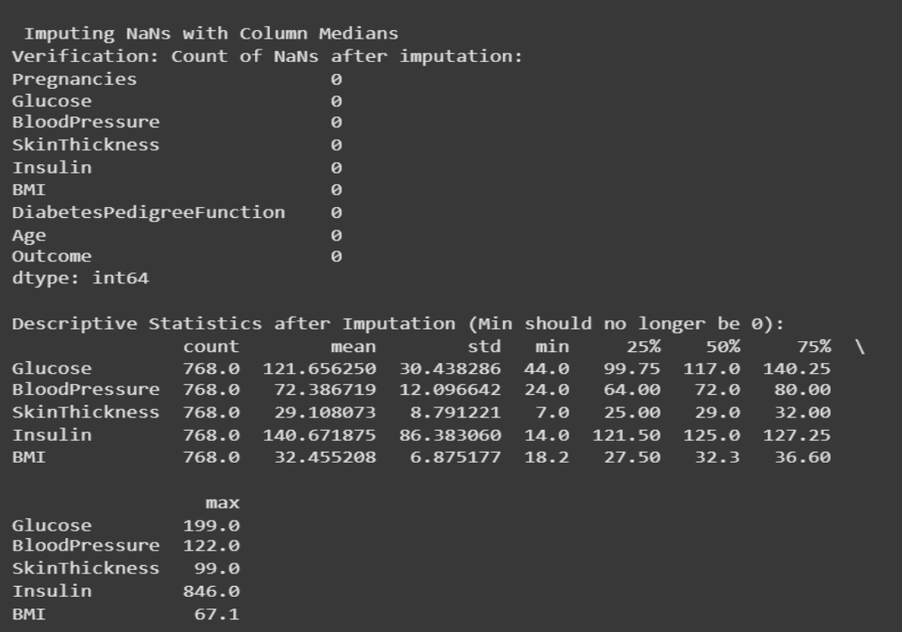
Data preparation
(CRISP-DM PHASE 3)
The dataset contained several missing and invalid values, such as zeros in attributes like glucose, BMI, and insulin. These were treated by replacing them with median values to maintain data consistency. The cleaned dataset was then scaled using StandardScaler to normalize feature ranges, ensuring balanced model performance during training.
3.1 Data Cleaning (Handling Invalid Zeros)
• All invalid zero values were replaced with NaN and then imputed with the column median to ensure robustness against outliers.
3.2 Feature Engineering and Scaling
• Features (X) were separated from the target (y), standardized using StandardScaler, and split into training and testing sets (80:20)

Slide 6
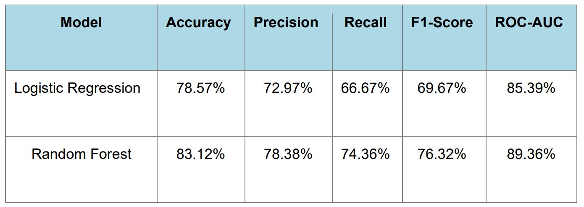
(CRISP-DM PHASE 4 & 5)
Modeling and Evaluation
Models Trained
Logistic Regression: A linear, interpretable model for baseline comparison.
Random Forest Classifier: An ensemble-based model providing higher accuracy and robustness.
Performance Metrics Comparison
A comparison between Logistic Regression and Random Forest is shown below.
Model Selection and Key Findings
Random Forest Classifier (Selected Model).
The model achieved the highest accuracy (83.12%) and ROC-AUC (89.36%), with Glucose and BMI identified as top predictors of diabetes risk.

Slide 7
Deployment:
(CRISP-DM PHASE 6)
Artifacts: final_diabrisk_model.pkl & scaler_diabrisk.pkl.
Framework: Streamlit.
Functionality: Real-time prediction using preprocessed health attributes.
Deployment Process:
The final machine learning model and preprocessing scaler were uploaded along with the Streamlit application script to a public GitHub repository.
A requirements.txt file was created to list all necessary dependencies for the app.
Using Streamlit Cloud, the repository was connected directly and deployed online.
This automated setup allowed the platform to install dependencies, run the app.py file, and generate a live web link for public access to the DiabRisk prediction app.

Slide 8

Conclusion
The DiabRisk project successfully applies machine learning to predict diabetes risk using key health parameters. By following the CRISP-DM process, we built, evaluated, and deployed a reliable model through an interactive Streamlit app. This project demonstrates how data-driven insights can support early diagnosis and promote better health awareness among individuals.
Future Work: Perform hyperparameter tuning, integrate larger datasets, and add model explainability tools (SHAP/LIME).

Slide 9
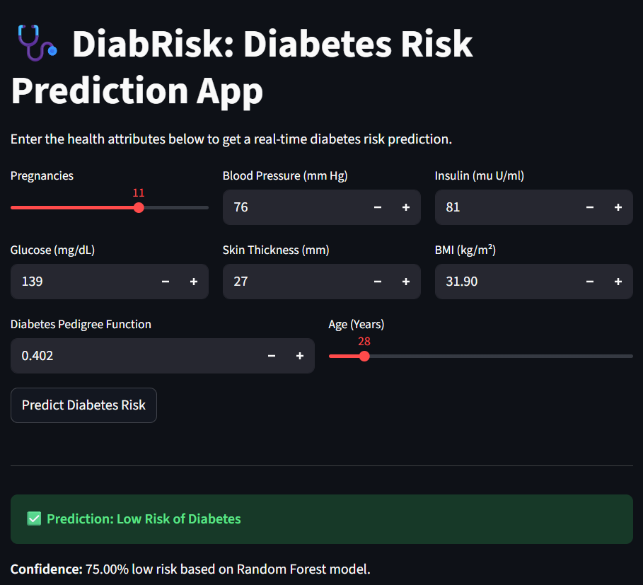
Thank you
App Link: https://diabriskapp-aey3ejqjrdqeuqpyujszxa.streamlit.app

